Slide 1

MALIGNANT COMMENT CLASSIFIER
By:- Vivek Kumar Singh

Slide 2
INTRODUCTION
Online forums and social media platforms have provided individuals with the means to put forward their thoughts and freely express their opinion on various issues and incidents. In some cases, these online comments contain explicit language which may hurt the readers. Comments containing explicit language can be classified into myriad categories such as Toxic, Severe Toxic, Obscene, Threat, Insult, and Identity Hate. The threat of abuse and harassment means that many people stop expressing themselves and give up on seeking different opinions.
To protect users from being exposed to offensive language on online forums or social media sites, companies have started flagging comments and blocking users who are found guilty of using unpleasant language. Several Machine Learning models have been developed and deployed to filter out the unruly language and protect internet users from becoming victims of online harassment and cyberbullying.
The background for the problem originates from the multitude of online forums, where-in people participate actively and make comments. The task was thus to build a model which could make prediction to classify the comments into various categories.

Slide 3
PROJECT TOPIC
Our goal is to build a prototype of online hate and abuse comment classifier which can used to classify hate and offensive comments so that it can be controlled and restricted from spreading hatred and cyberbullying.
This project is more about exploration, feature engineering and classification that can be done on this data. Since the data set is huge and includes many categories of comments, we can do good amount of data exploration and derive some interesting features using the comments text column available. You need to build a model that can differentiate between comments and its categories.

Slide 4
DATA SET DESCRIPTION
The data set contains the training set, which has approximately 1,59,000 samples and the test set which contains nearly 1,53,000 samples. All the data samples contain 8 fields which includes ‘Id’, ‘Comments’, ‘Malignant’, ‘Highly malignant’, ‘Rude’, ‘Threat’, ‘Abuse’ and ‘Loathe’.
The label can be either 0 or 1, where 0 denotes a NO while 1 denotes a YES. There are various comments which have multiple labels. The first attribute is a unique ID associated with each comment.
The data set includes:
Malignant: It is the Label column, which includes values 0 and 1, denoting if the comment is malignant or not.
Highly Malignant: It denotes comments that are highly malignant and hurtful.
Rude: It denotes comments that are very rude and offensive.
Threat: It contains indication of the comments that are giving any threat to someone.
Abuse: It is for comments that are abusive in nature.
Loathe: It describes the comments which are hateful and loathing in nature.
ID: It includes unique Ids associated with each comment text given.
Comment text: This column contains the comments extracted from various social media platforms.

Slide 5
MODELS UNDER THE PROJECT
Models build for predictions are:-
Linear svc
Multinomial naive bayes
Logistic regression
LGBM Classifier
SDG Classifier
Random Forest Classifier

Slide 6
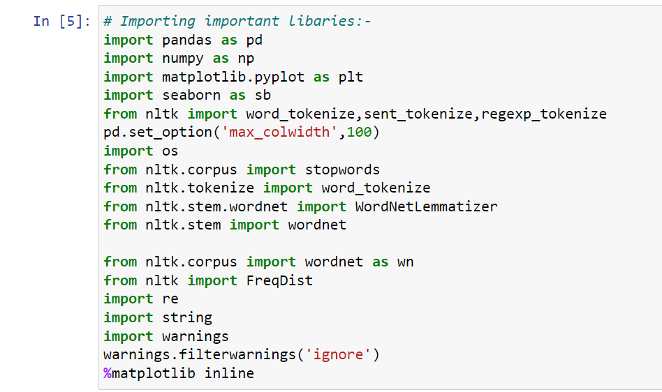
Importing libraries
These are the basic libraries which we import for
operation done in machine learning

Slide 7
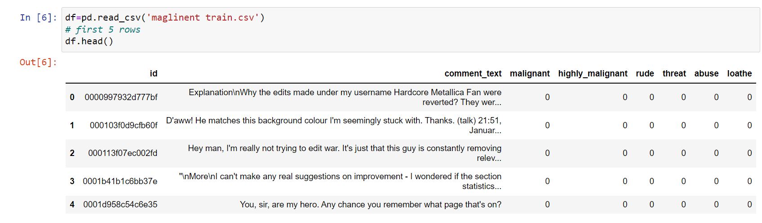
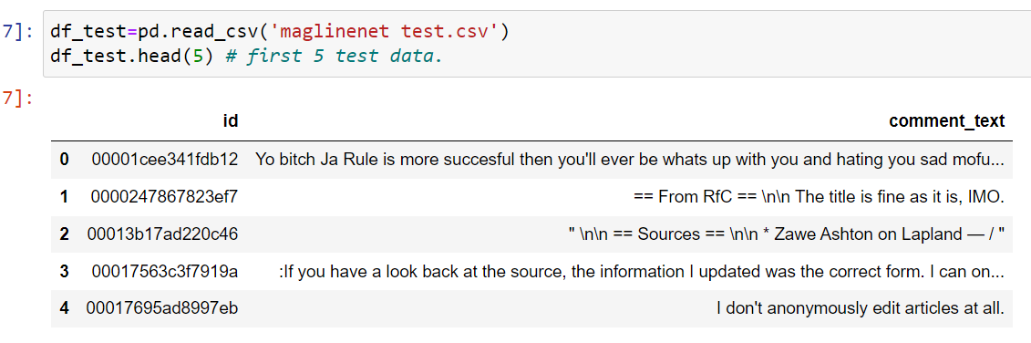
Importing train and test Data
Imported train and test dataset
This is train and test dataset looks like
Train dataset has label columns ,
While test dataset has only feature columns

Slide 8
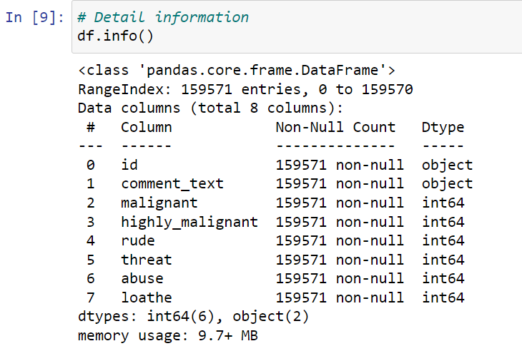
Data Detail info.
All the information is given here :-
No null values in any columns
two columns are object “id ” and
“comment_text”
All columns has 159571 rows.
All integer columns are Data type of int 64
No float Datatype

Slide 9
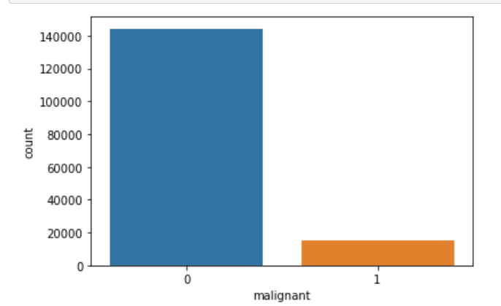
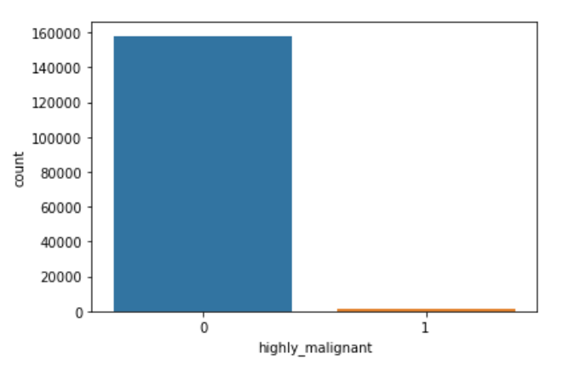
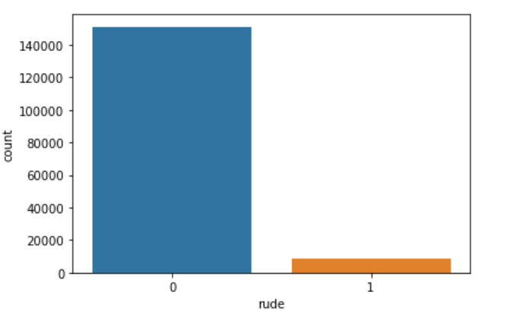
Exploratory Data analysis
All target variable analysis

Slide 10
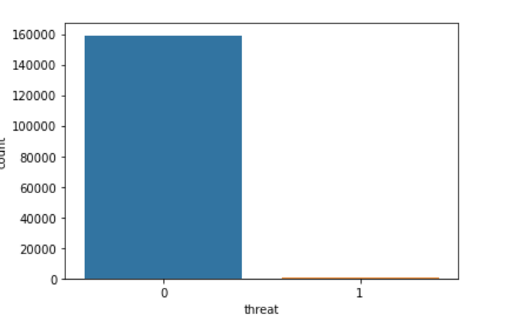
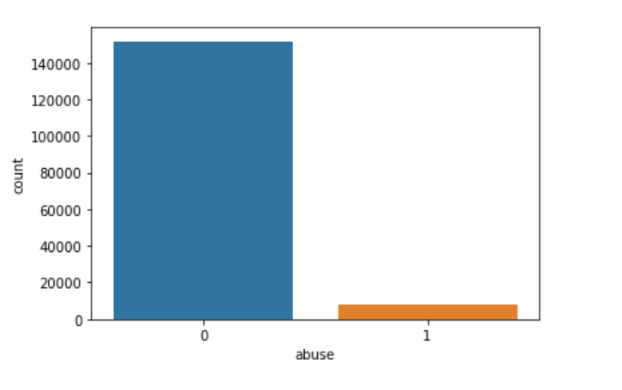
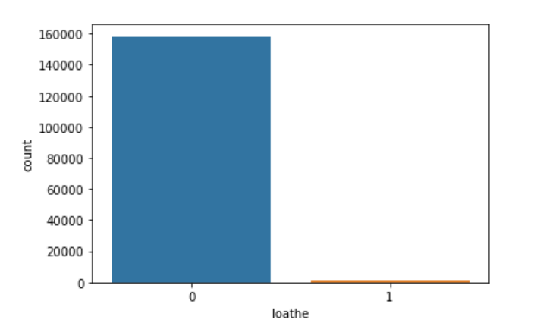
EDA of Target variable

Slide 11
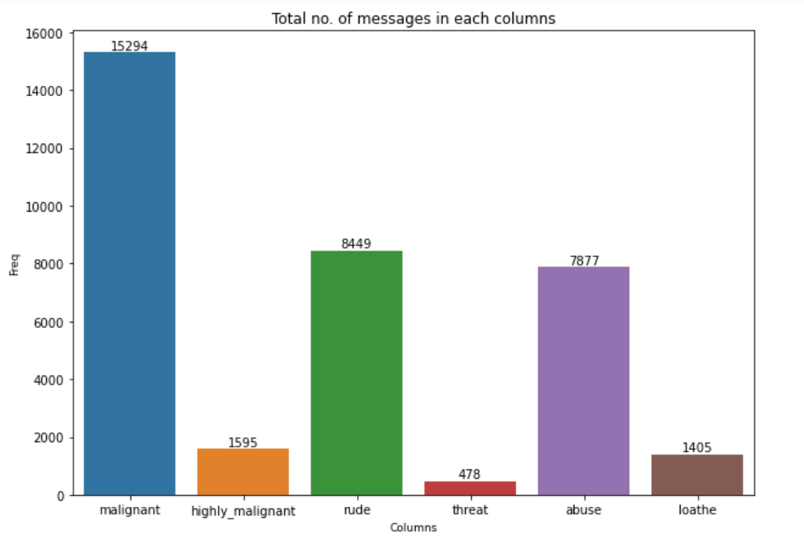
Number of message of each columns

Slide 12
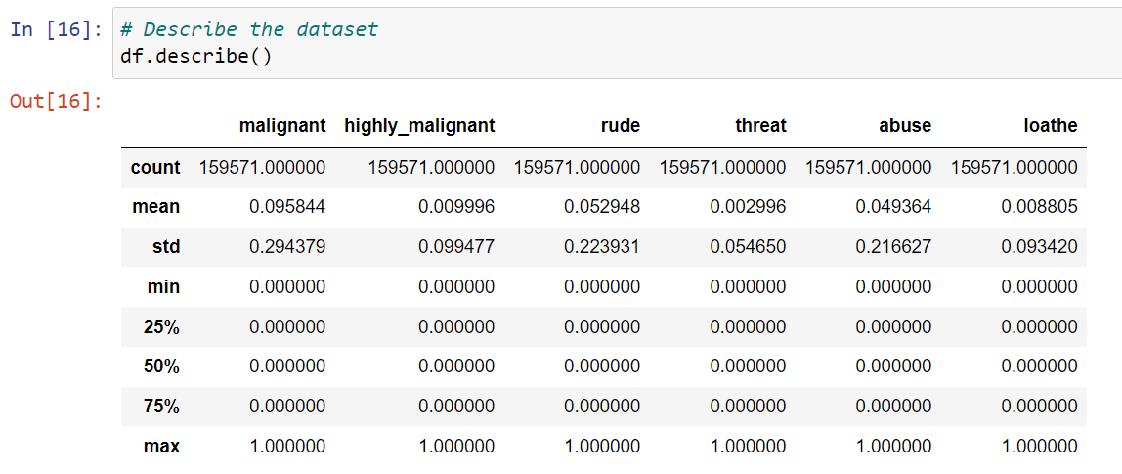
Describe the dataset
This shows the following
Mean
Standard deviation
Outliers (25% ,50%,75%)
Max and min
Total count of rows

Slide 13
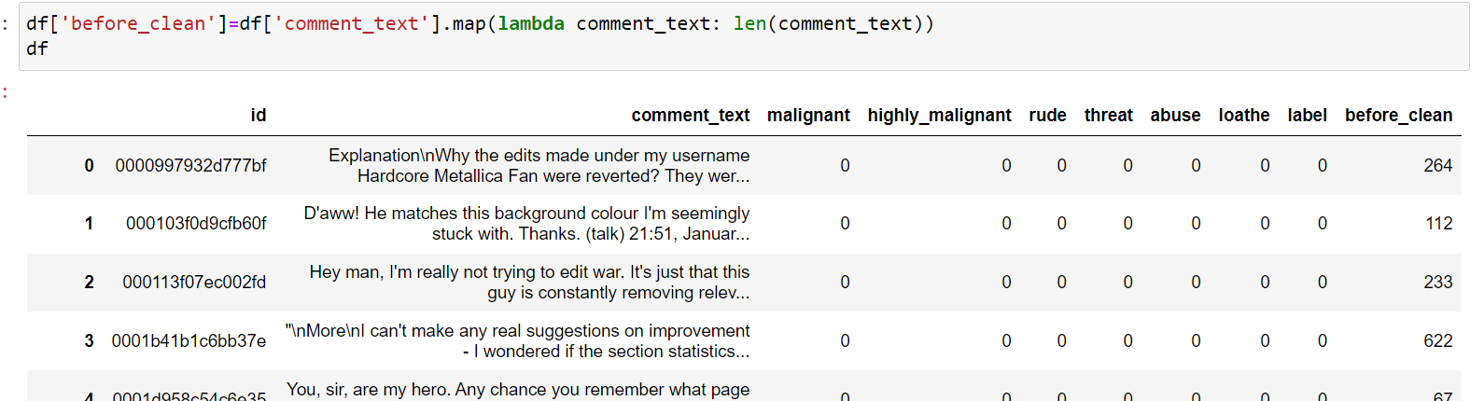
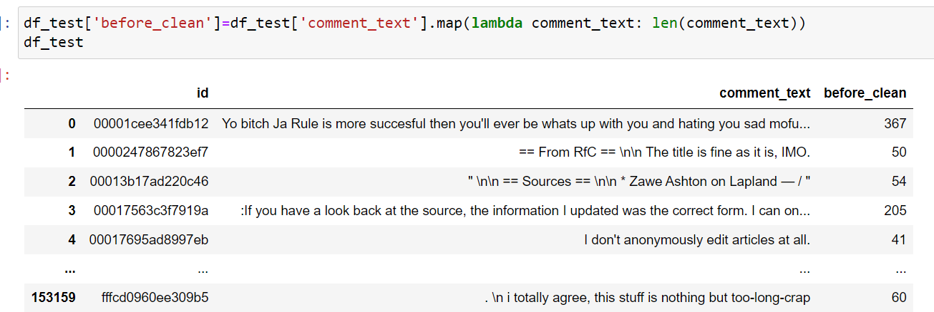
Before cleaning the train and text data

Slide 14
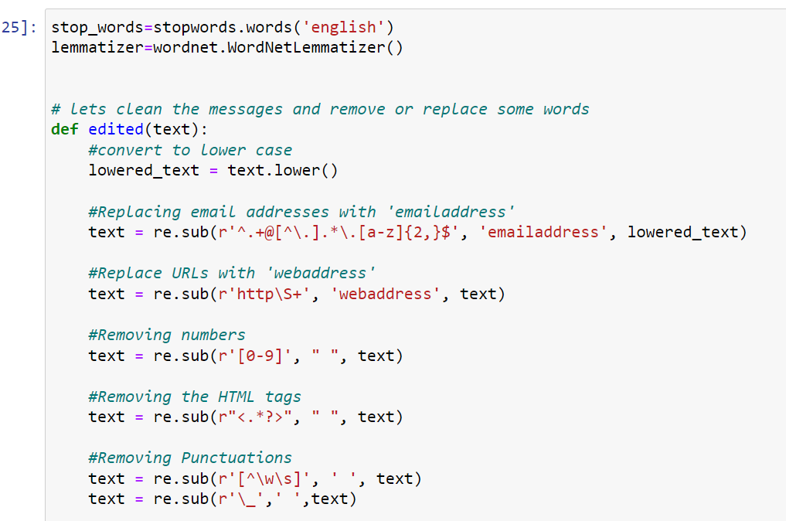
Text preprocessing
Cleaning all text columns here
Stop words
Punctuation
HTML tags
Web address
Email address

Slide 15
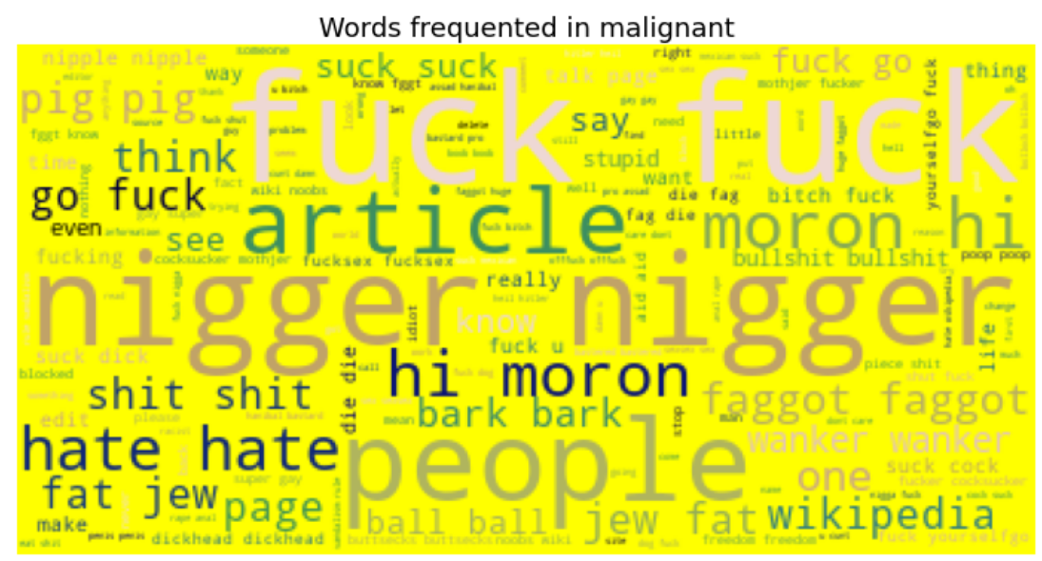
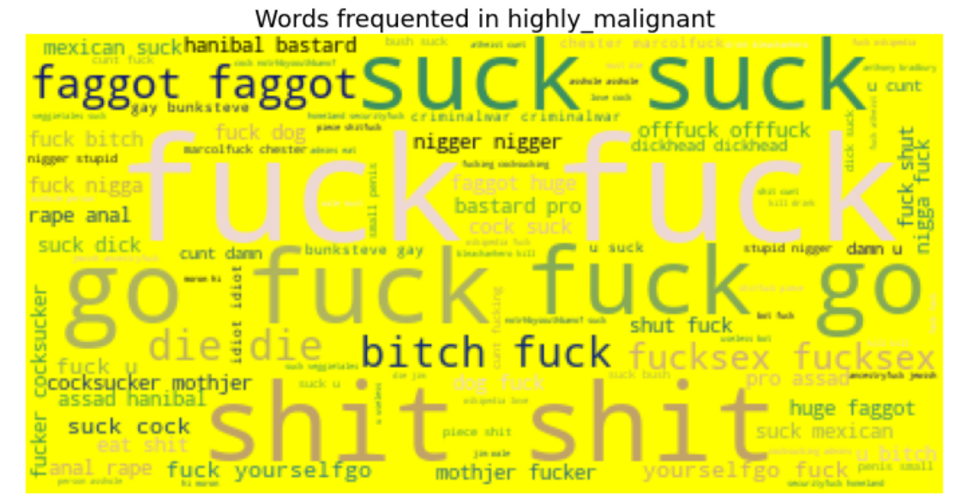
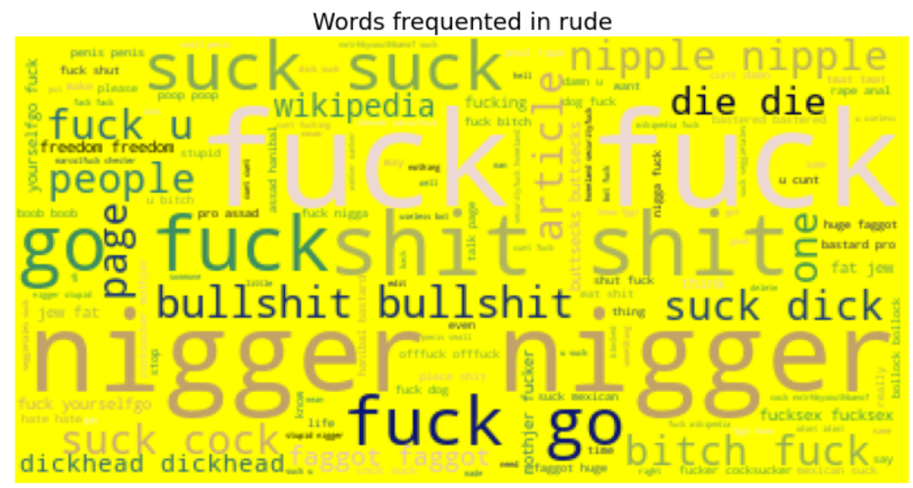
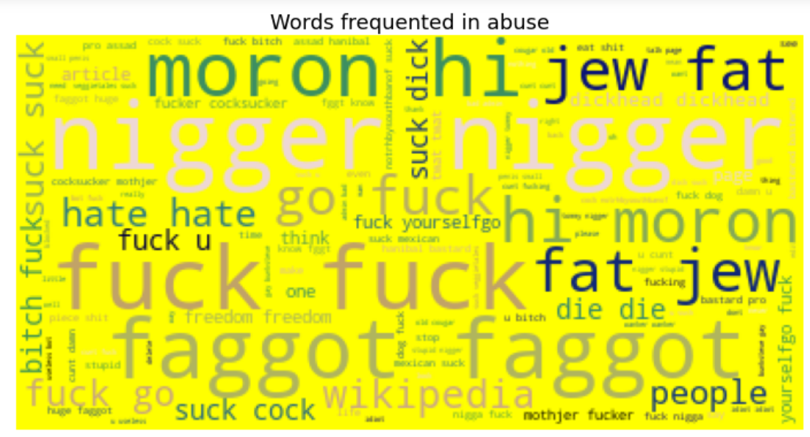
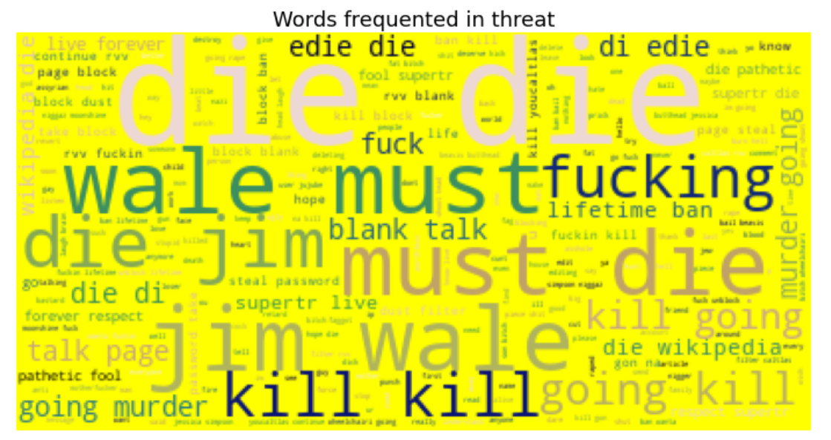
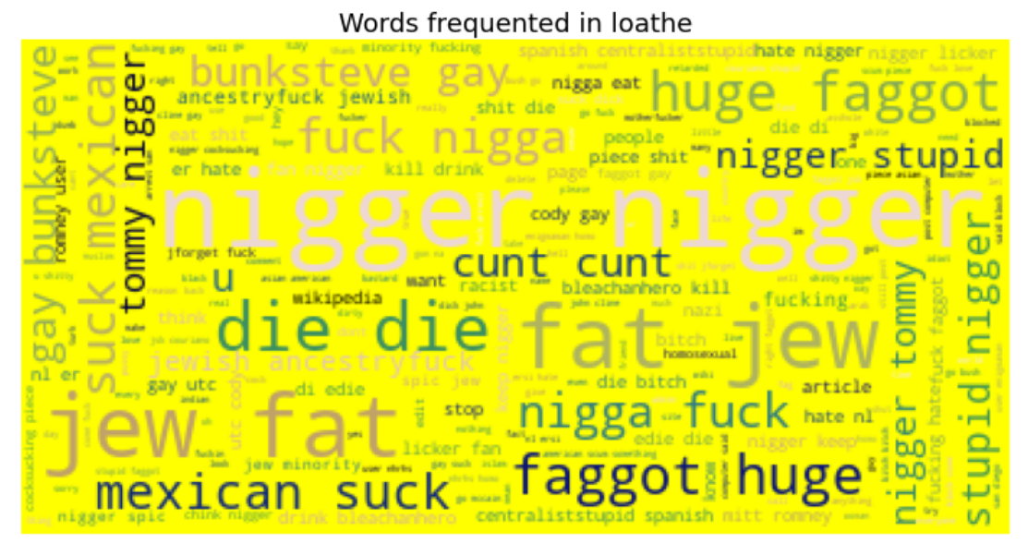
Frequent words in Feature columns
Here we see all types of comments in dataset

Slide 16
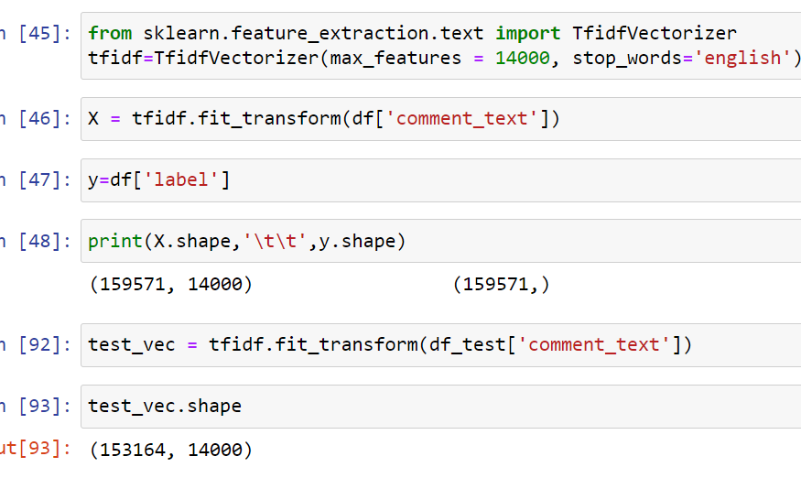
Vectorization
we use vectorizer to bring text into numeric values so it can predict weather it is malignant or not.

Slide 17
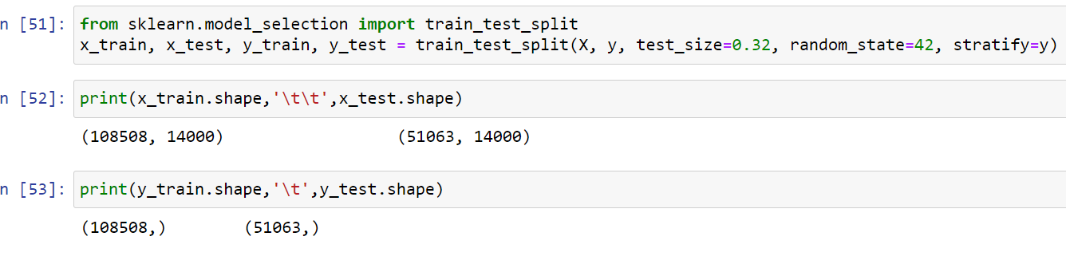
Train and test splitting data
Splitting data into train and test to train the models

Slide 18
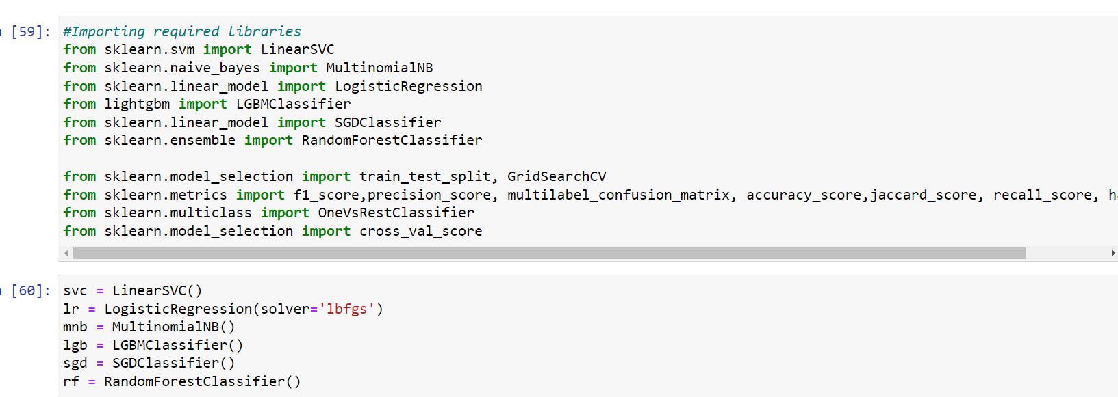
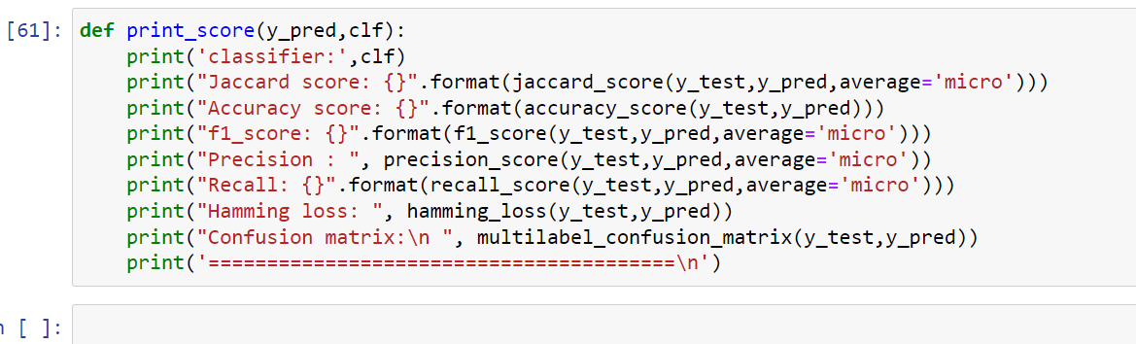
Importing model building libraries
Importing important libraries for machine learning algorithms and creating models

Slide 19
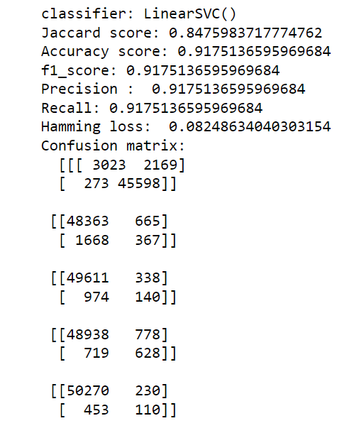
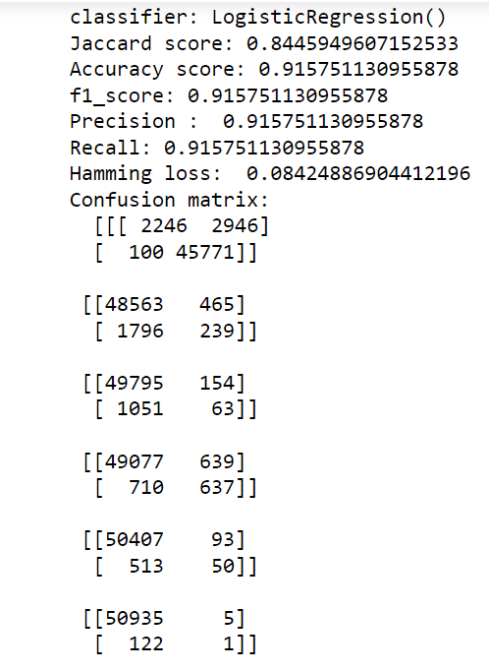
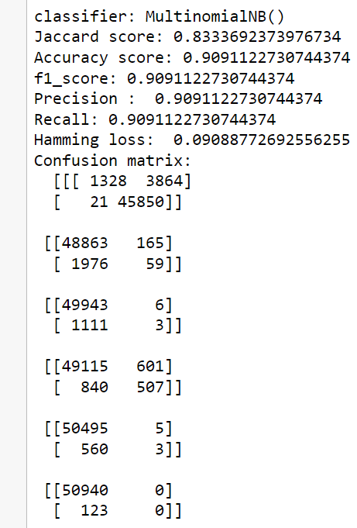
Models outputs
Support vector machine == Linear svc
Logistic regression
Multinomial naïve bayes

Slide 20
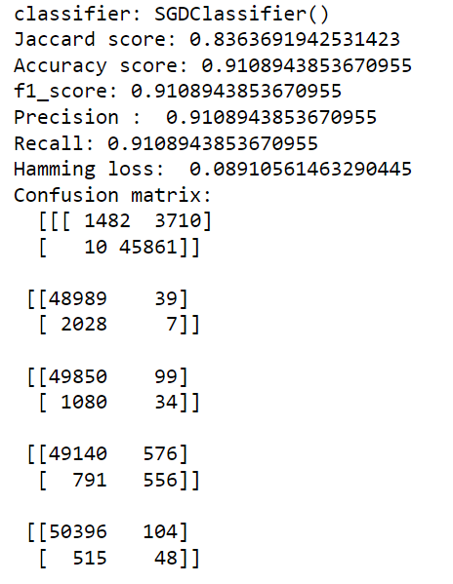
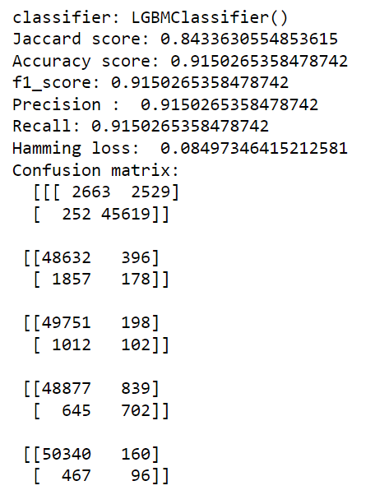
Model output
Linear model -SDG Classifier
LGBM Classifier

Slide 21
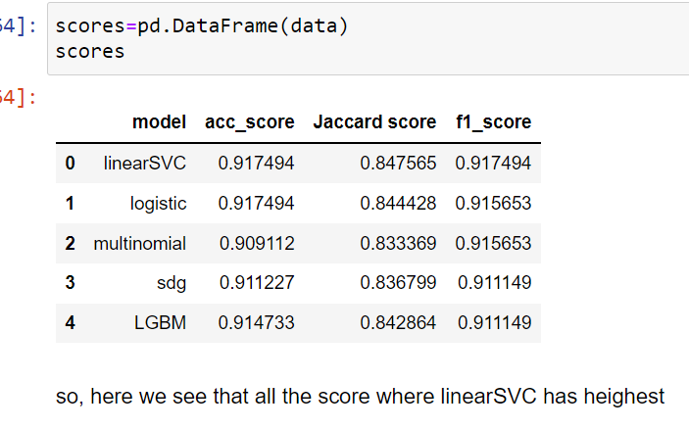
Score analysis
We analyze here all different type of score,
And its clear that Linear SVC has the highest score among all
Accuracy score:-0.9174 Jaccard score:-0.8475 f1score:-0.9174

Slide 22
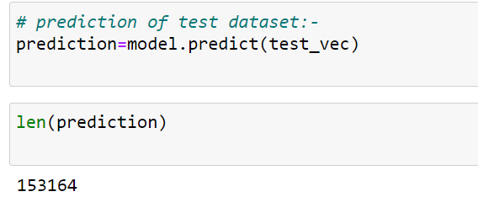
Prediction
Predicting the test dataset as we have and we get the results.

Slide 23
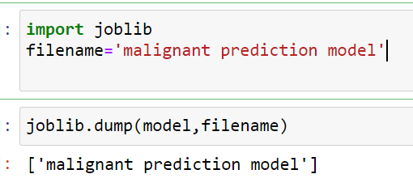
Saving the model
Model saved

